Slide 1
FSR Regression Results
Paper-aware machine learning for flame spread rate prediction
Tartget: predict Flame Spread Rate (FSR)
Main question: how well does the model extrapolate to a completely unseen paper/campaign?
Headline: MLP gives the best final unseen-paper holdout RMSE, KNN is close; oxygen concentration is the strongest driver.
Notes:
Open by saying this is not a random-row prediction exercise. The key audience takeaway is honest extrapolation to new papers, not interpolation within papers already seen during training.

Slide 2
Why the paper-aware split matters
Rows from the same paper share facility, team, diagnostics, material batches, and operating ranges.
A random split can put the same paper in both training and test, inflating apparent performance.
The primary result uses group-aware splitting by Article (MLA): a paper is entirely train or entirely test.
Hyperparameter search uses GroupKFold so validation folds also hold out complete papers.
Notes:
Use this slide to set expectations: lower group-aware metrics are not a failure. They are the more realistic estimate of performance on a new campaign.

Slide 3
Data and modeling pipeline
0 | 1
Initial rows | 5118
Rows with valid FSR | 2605
Unique papers | 69
Target | FSR (Flame Spread Rate)
Grouping key | Article (MLA)
Features used | 8 numeric + 6 categorical
Target is parsed numerically from the FSR column.
Post-experiment outputs and paper identifiers are removed to prevent leakage.
Numeric columns are imputed/scaled; categorical columns are one-hot encoded with unknown categories ignored.
Models compared: Decision Tree, XGBoost, KNN, and MLP.
Notes:
Mention that the code automatically detects target, group, leakage columns, and feature types, which makes the pipeline less brittle but still requires review of parsed features.

Slide 4
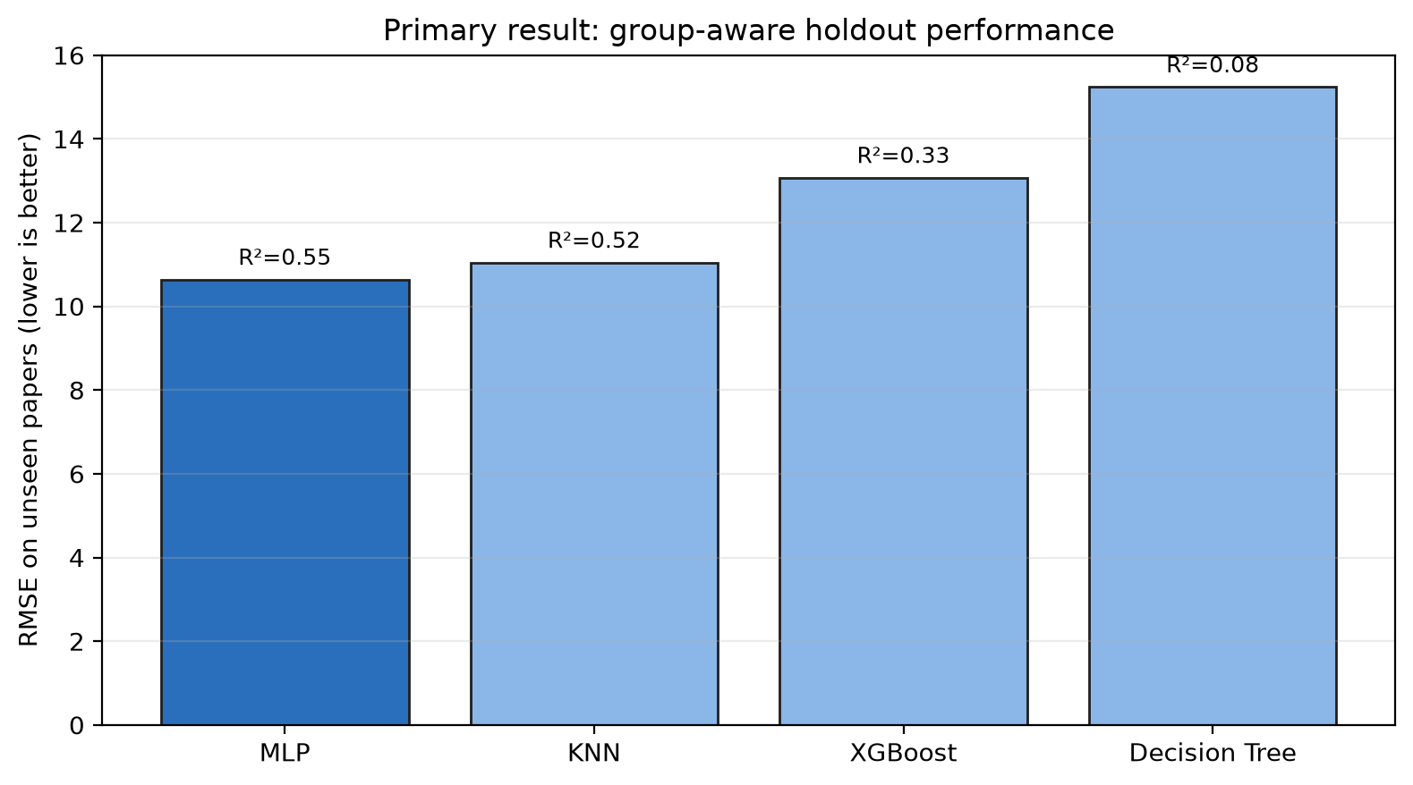
Primary holdout result: unseen-paper performance
Model | R2 | RMSE | MAE | MAPE | MBE
MLP | 0.553 | 10.643 | 5.841 | 215.872 | 2.872
KNN | 0.519 | 11.047 | 5.619 | 216.017 | 2.166
XGBoost | 0.326 | 13.075 | 6.409 | 282.505 | 2.206
Decision Tree | 0.084 | 15.241 | 7.398 | 295.594 | 2.829
MLP is best on this final group holdout (RMSE 10.64, R² 0.55), with KNN close. Tree models trail on the same held-out papers.
Notes:
Say the final holdout ranking is MLP, KNN, XGBoost, Decision Tree. Do not overstate MLP dominance because KNN is close and paper-level variance is large.
DT, or Decision Tree, is a model that makes predictions by splitting the data into a sequence of simple yes/no rules. It is easy to interpret because you can trace the path from the input features to the final prediction. Its main weakness is that a single tree can overfit if it grows too deep.
XGB, or XGBoost, is an ensemble method that combines many small decision trees to improve prediction accuracy. Each new tree is trained to correct the errors made by the previous ones, which makes the model strong at capturing complex patterns. It is usually more accurate than a single tree, but less interpretable.
KNN, or K-Nearest Neighbors, predicts a value by looking at the most similar training examples. It does not learn a fixed parametric model; instead, it relies on the distance between new points and existing points in the dataset. It is simple and intuitive, but can become slow and sensitive to feature scaling when the dataset is large.

Slide 5
Model selection caveat: CV choice vs final holdout
Model | GroupKFold CV RMSE
Decision Tree | 12.940
XGBoost | 13.275
KNN | 13.414
MLP | 13.826
metrics.json marks Decision Tree as best by GroupKFold CV RMSE.
The final group holdout table ranks Decision Tree last and MLP first.
This mismatch means one paper split is noisy; paper-level composition strongly affects conclusions.
Presentation recommendation: show both and propose repeated group splits before making a final model claim.
On this held-out paper split, MLP performs best; CV selection is unstable and needs repeated-group validation.
Notes:
This slide is important because it prevents overclaiming. A skeptical reviewer will notice the CV/holdout mismatch if they inspect the result files.

Slide 6
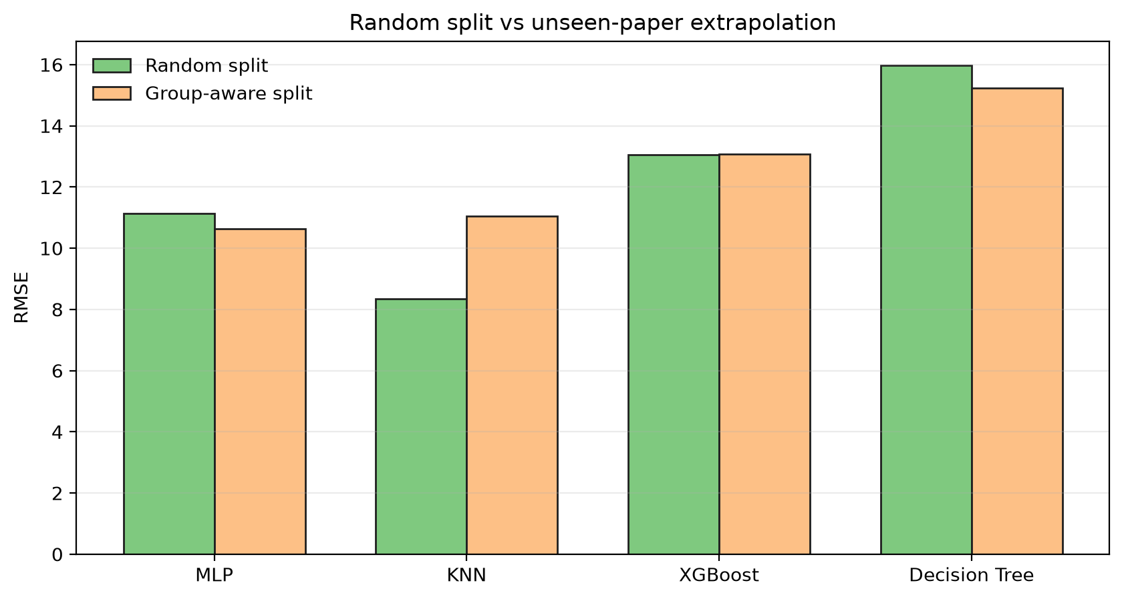
Random split looks better for some models
Model | Random RMSE | Group RMSE | Generalization Gap
MLP | 11.130 | 10.643 | -0.487
KNN | 8.337 | 11.047 | 2.710
XGBoost | 13.059 | 13.075 | 0.017
Decision Tree | 15.971 | 15.241 | -0.730
KNN shows the clearest optimism: RMSE rises from 8.34 random to 11.05 group-aware.
Notes:
Explain that random split performance can be real interpolation skill, but not evidence that a model will transfer to a new paper. Some negative gaps are possible because the two test sets are not identical in target distribution.

Slide 7
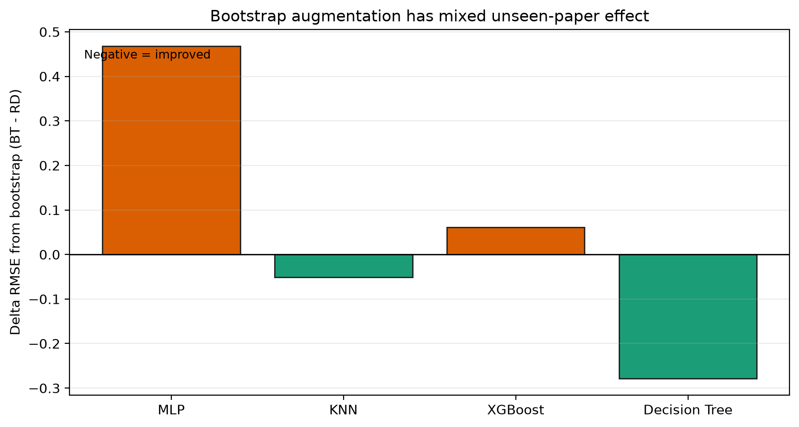
Bootstrap augmentation: not a universal improvement
Model | Group RMSE (RD) | Group RMSE (RD+BT) | Group dRMSE (BT-RD)
MLP | 10.643 | 11.111 | 0.468
KNN | 11.047 | 10.996 | -0.051
XGBoost | 13.075 | 13.136 | 0.061
Decision Tree | 15.241 | 14.963 | -0.278
BT is marginal for KNN and Decision Tree, slightly harmful for MLP/XGBoost in the current CSVs; do not center the presentation around augmentation gains.
Notes:
Say bootstrap samples are drawn only from training papers, so the setup avoids leakage. The result is mixed, so the main story should stay model generalization and feature drivers.

Slide 8
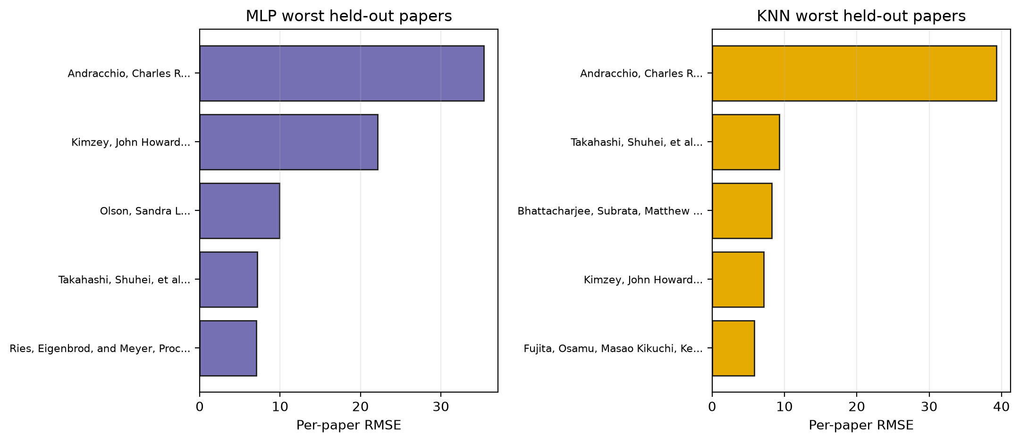
Paper-level errors: averages hide failure modes
Worst-case papers dominate aggregate RMSE.
Older NASA/weightlessness datasets and high-FSR campaigns are recurring hard cases.
Use per-paper tables to discuss where extrapolation fails, not only average RMSE.
Notes:
This is the best slide for scientific interpretation. The model is not equally wrong everywhere; it struggles when a held-out paper occupies a different experimental regime.

Slide 9
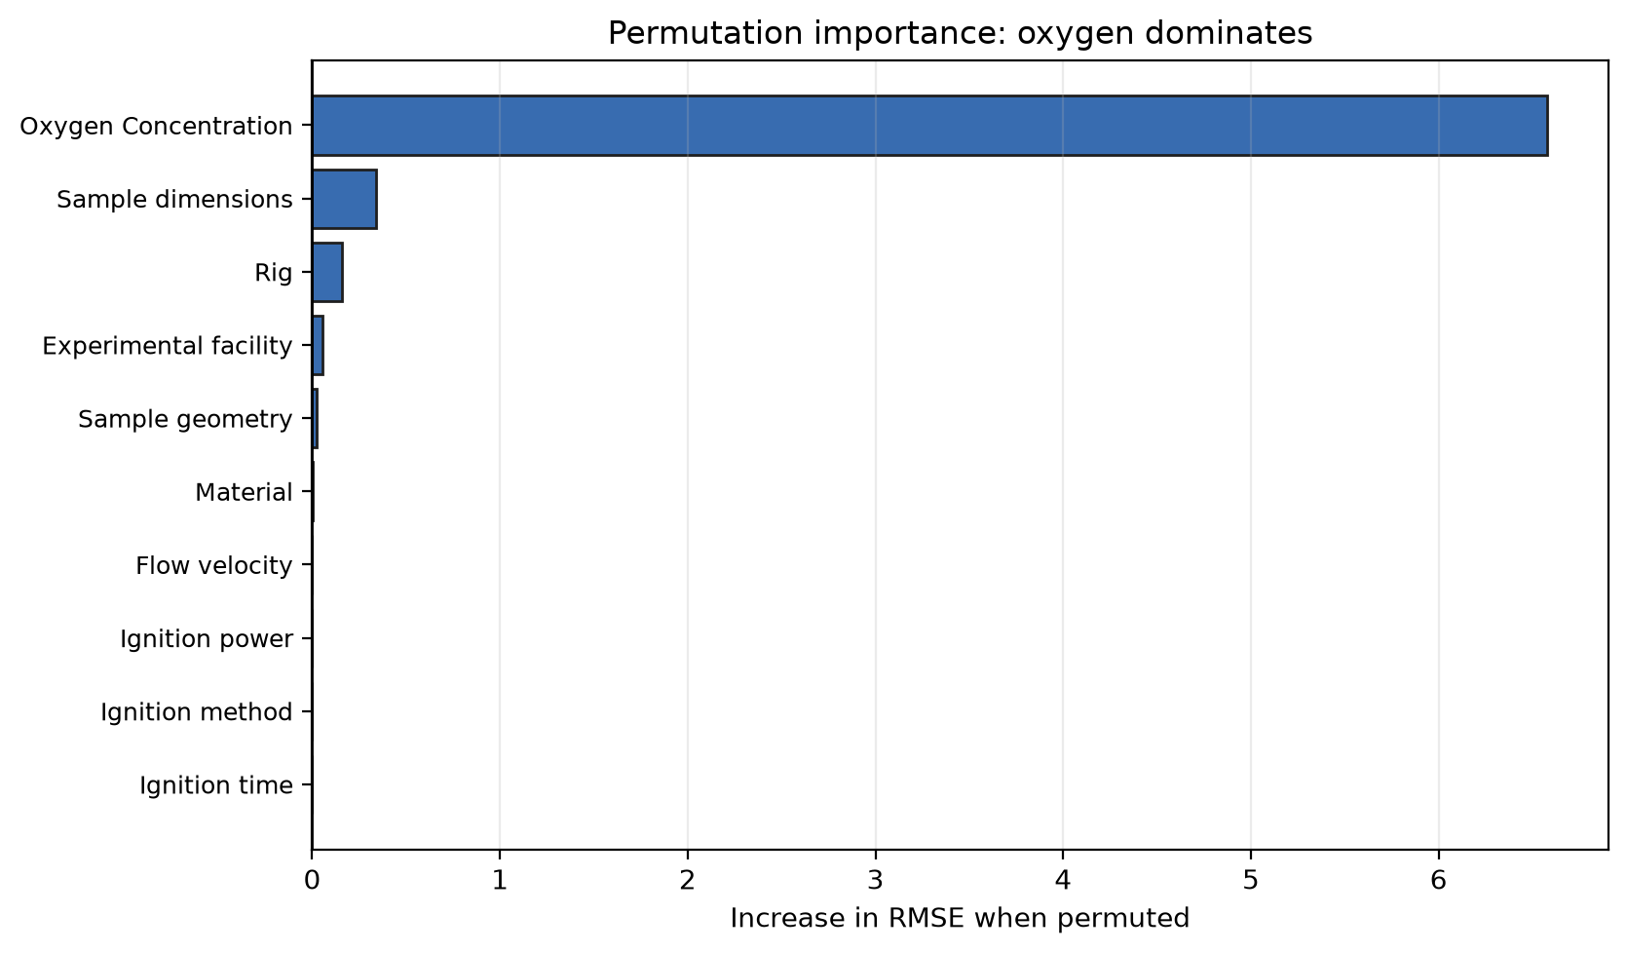
Feature drivers from permutation importance
Oxygen concentration is the dominant predictor by a large margin.
Sample dimensions, rig, facility, geometry, and material add secondary information.
Negative permutation values indicate noisy/proxy features where shuffling did not hurt RMSE on this split.
Physical read: oxidizer availability leads; geometry and campaign context define the transport regime.
Notes:
Avoid saying negative pressure importance means pressure is physically unimportant. It means this trained model/split did not rely on pressure in a stable way under permutation.

Slide 10
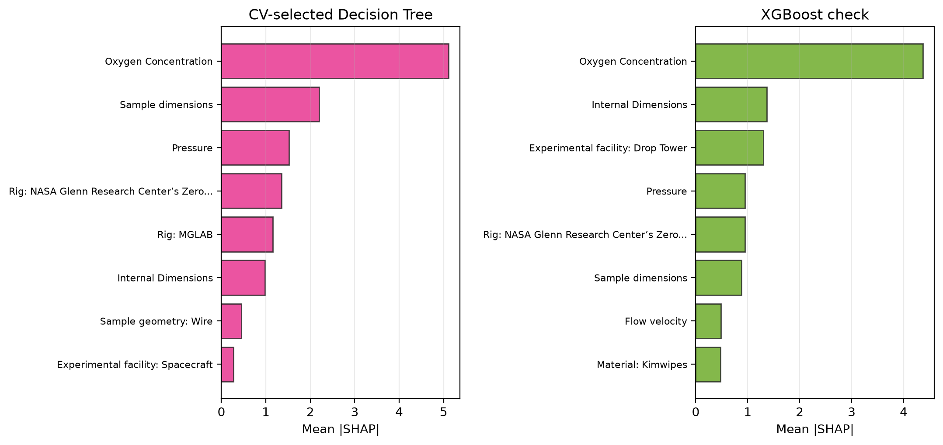
SHAP interpretation: robust drivers across tree checks
oxygen, size/geometry, pressure, rig/facility, and material explain most model movement.
Notes:
Use SHAP as a qualitative explanation, not causal proof. The presence of rig/facility variables says the model is learning campaign context as well as physics.

Slide 11
Conclusions for the results talk
The honest evaluation is unseen-paper extrapolation, not random-row interpolation.
Current final holdout: MLP has the lowest group-aware RMSE (10.64) and highest R² (0.55); KNN is close.
Random split overstates KNN performance and should not be used as the primary claim.
Bootstrap resampling has mixed effects and is not the main performance driver.
Oxygen concentration is the strongest and most physically plausible driver; geometry, pressure, facility/rig, and material are secondary.
Next result to add before publication: repeated GroupShuffleSplit / nested group validation to resolve CV-vs-holdout instability.
Notes:
End with a balanced claim: promising extrapolation signal exists, but single-split sensitivity is the main limitation to address.

